Slide 1

Digital Image Processing
Chapter6: Affine Transformation
Dr. Mohammad Javad Parseh
Jahrom University
Department of Computer Engineering and Information Technology
October 2024

Slide 2
Introduction
An affine transformation is a geometric transformation that preserves points, lines and planes. It satisfies the following conditions:
Collinearity: Points which lie on a line before the transformation continue to lie on the line after the transformation.
Parallelism: Parallel lines will continue to be parallel after the transformation.
Convexity: A convex set will continue to be convex after the transformation.
Ratios of parallel line segments: The ratio of the length of parallel line segments will continue to be the same after transformation.
In this chapter, we will discuss the common affine transformation such as translation, rotation and scaling.

Slide 3
Affine Transformation
The affine transformation is applied as follows:
Consider every pixel coordinate in the image.
Calculate the dot product of the pixel coordinate with a transformation matrix.
Determine the pixel value in the transformed image using the pixel coordinate calculated from the previous step.

Slide 4
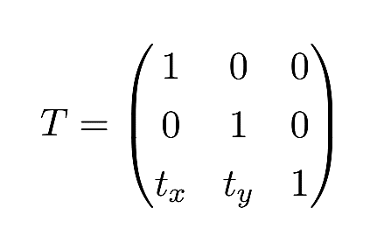
Translation
Translation is the process of shifting the image along the various axes (x-, y- and z-axis).
For a 2D image, we can perform translation along one or both axes independently.
The transformation matrix for translation is defined as:

Slide 5
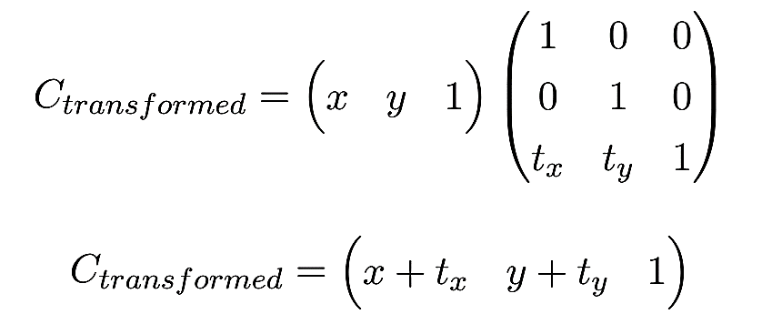
Translation (cont.)
If we consider a pixel coordinate (x, y, 1) and perform the dot product with the translation matrix, we will obtain the pixel coordinate of the transformed matrix.
Thus every pixel in the transformed image is offset by t_{x} and t_{y} along x and y respectively. The value of t_{x} and t_{y} may be positive or negative.

Slide 6
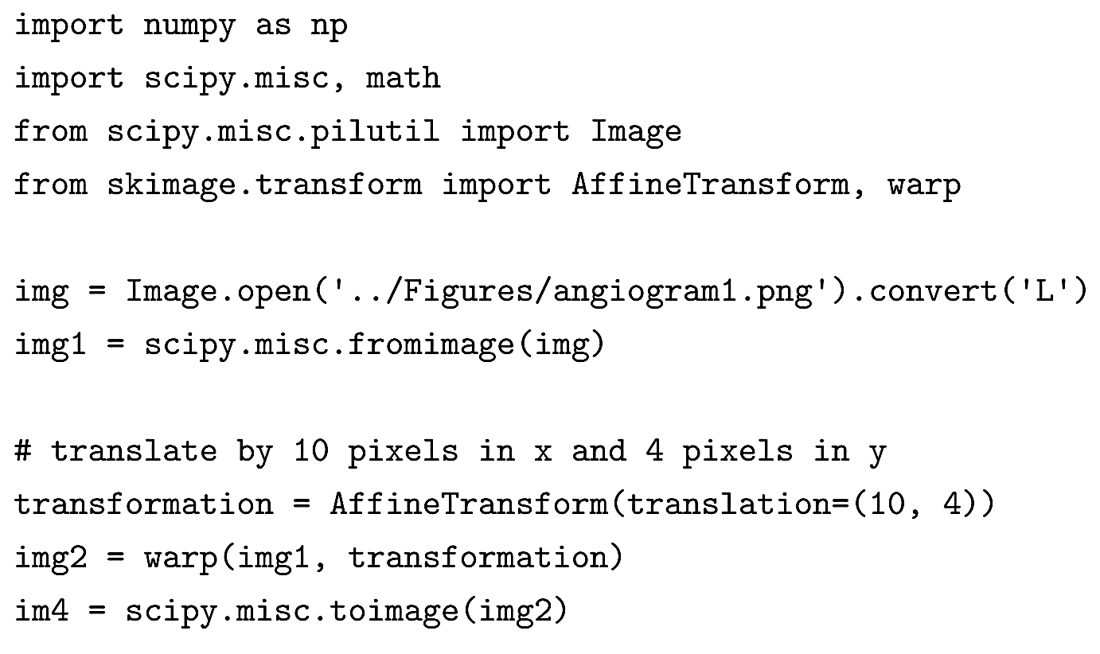
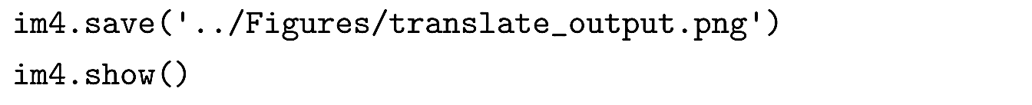
Translation (cont.)

Slide 7
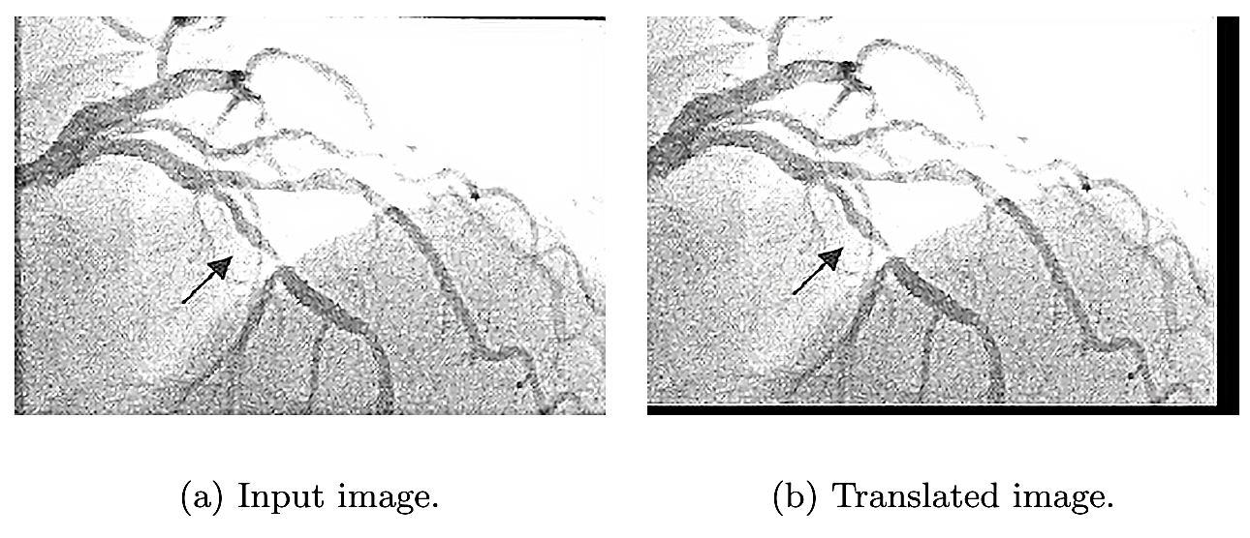
Translation (cont.)

Slide 8
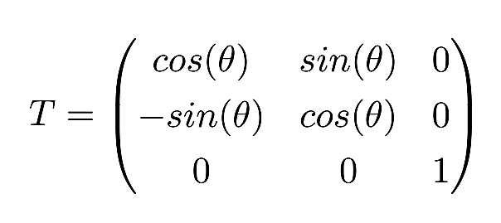
Rotation
Rotation is the process of changing the radial orientation of an image along the various axes with respect to a fixed point.
The transformation matrix for a counter-clockwise rotation is defined as:

Slide 9
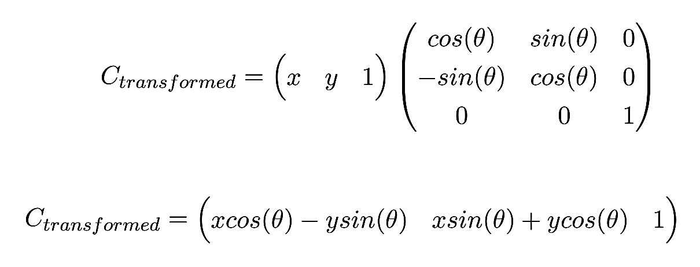
Rotation (cont.)
If we consider a pixel coordinate (x, y, 1) and perform the dot product with the rotation matrix, we will obtain the pixel coordinate for the rotated matrix.

Slide 10
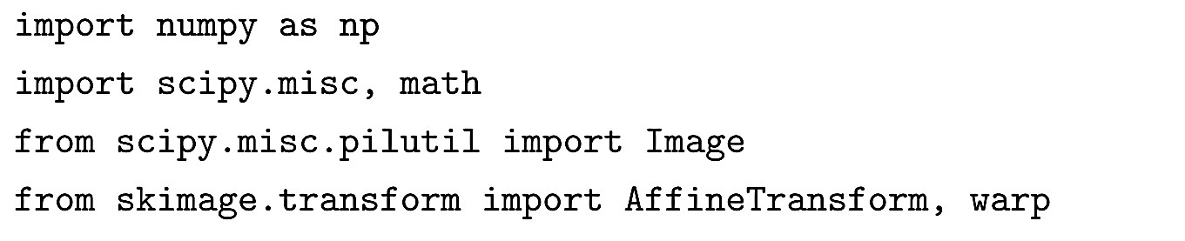
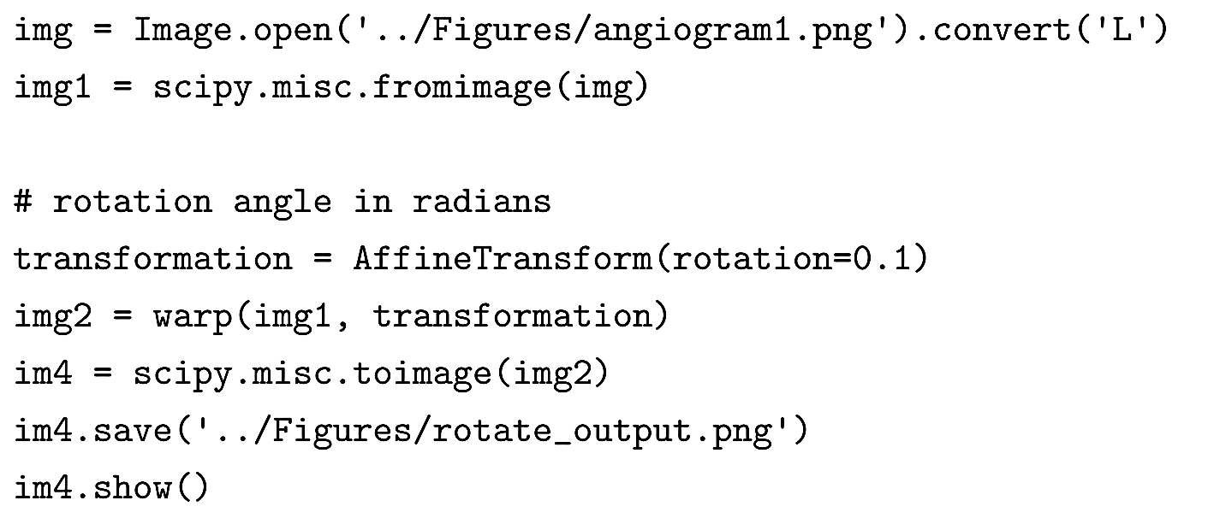
Rotation (cont.)

Slide 11
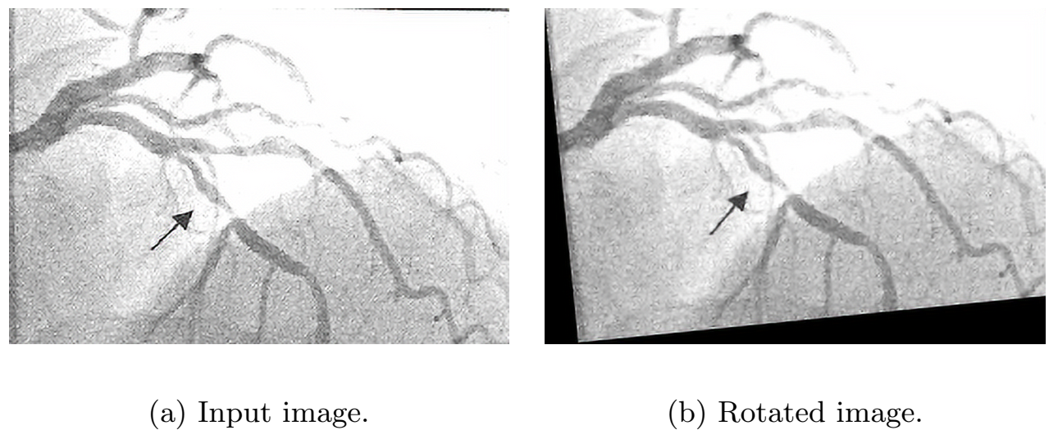
Rotation (cont.)

Slide 12
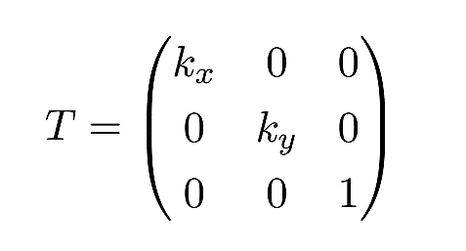
Scaling
Scaling is a process of changing the distance (compression or elongation) between points in one or more axes. This change in distance causes the object in the image to appear larger or smaller than the original input.
The scaling factor may be different across different axes. The transformation matrix for scaling is defined as:

Slide 13
Scaling (cont.)
If the value of k_{x} or k_{y} is less than 1, then the objects in the image will appear smaller ,and missing pixel values will be filled with 0 or based on the value of the warp parameter.
If the value of k_{x} or k_{y} is greater than 1, then the objects in the image will appear larger.
If the value of k_{x} and k_{y} are equal, the image is compressed or elongated by the same amount along both axes.

Slide 14
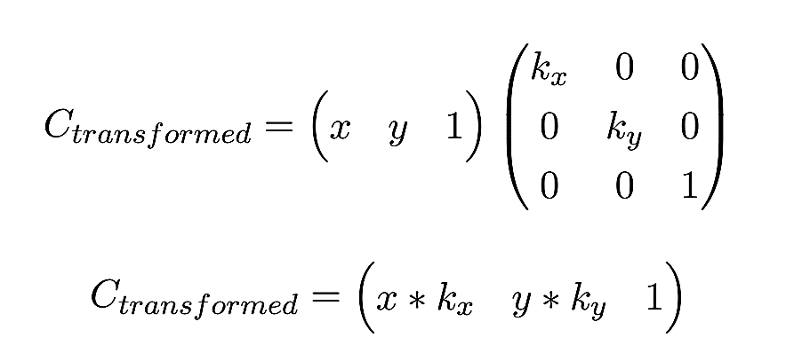
Scaling (cont.)
If we consider a pixel coordinate (x, y, 1) and perform the dot product with the scaling matrix, we will obtain the pixel coordinate for the scaled matrix.

Slide 15
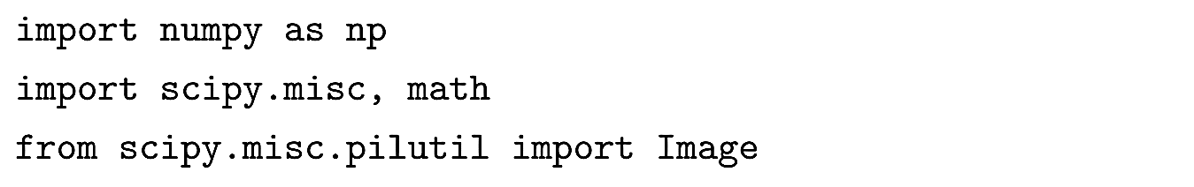
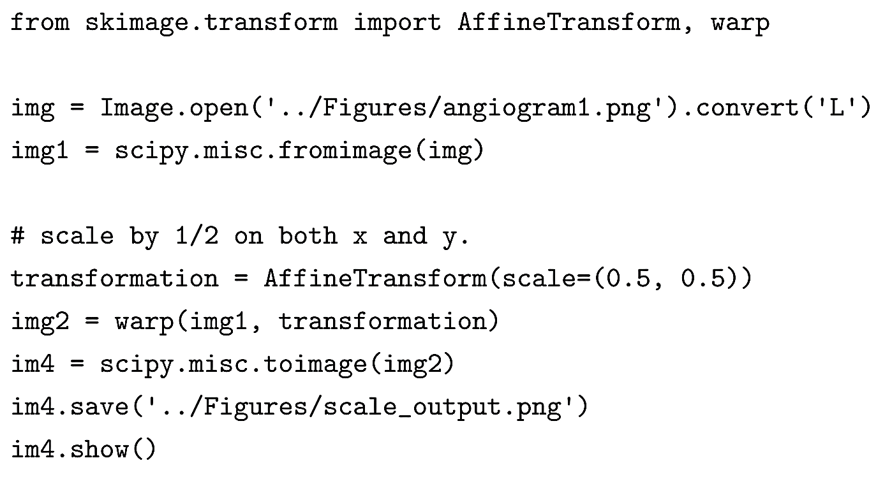
Scaling (cont.)

Slide 16
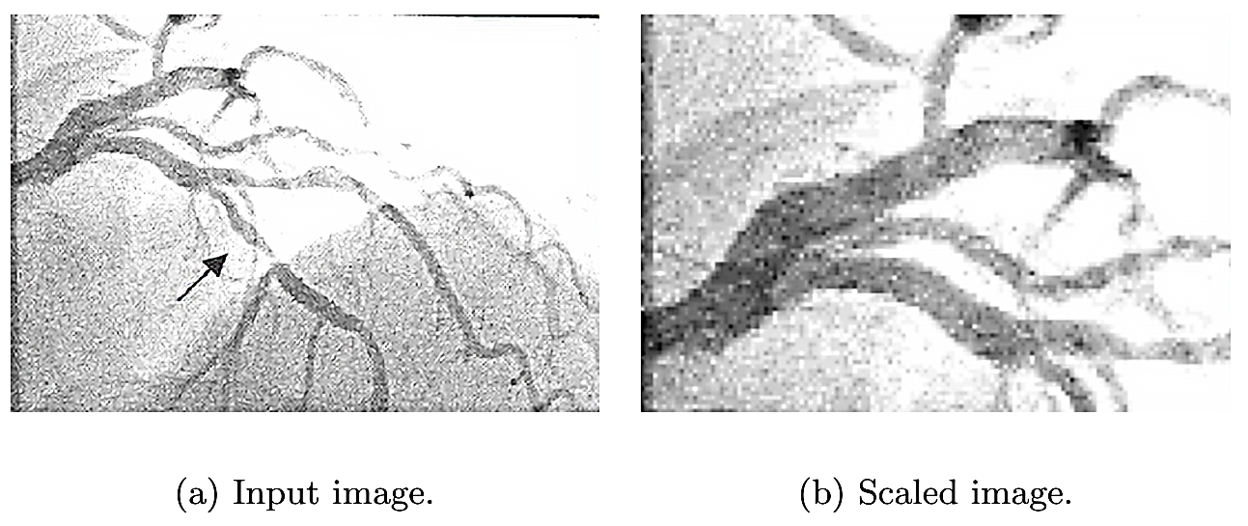
Scaling (cont.)

Slide 17
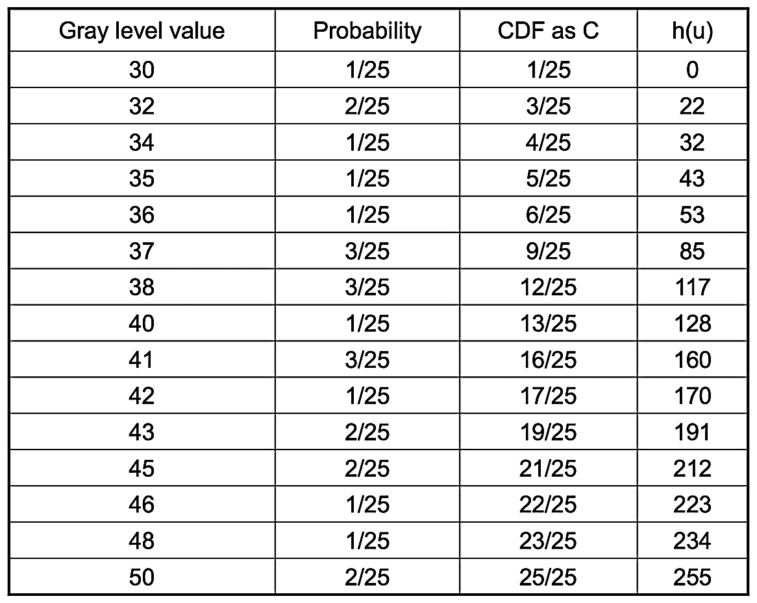
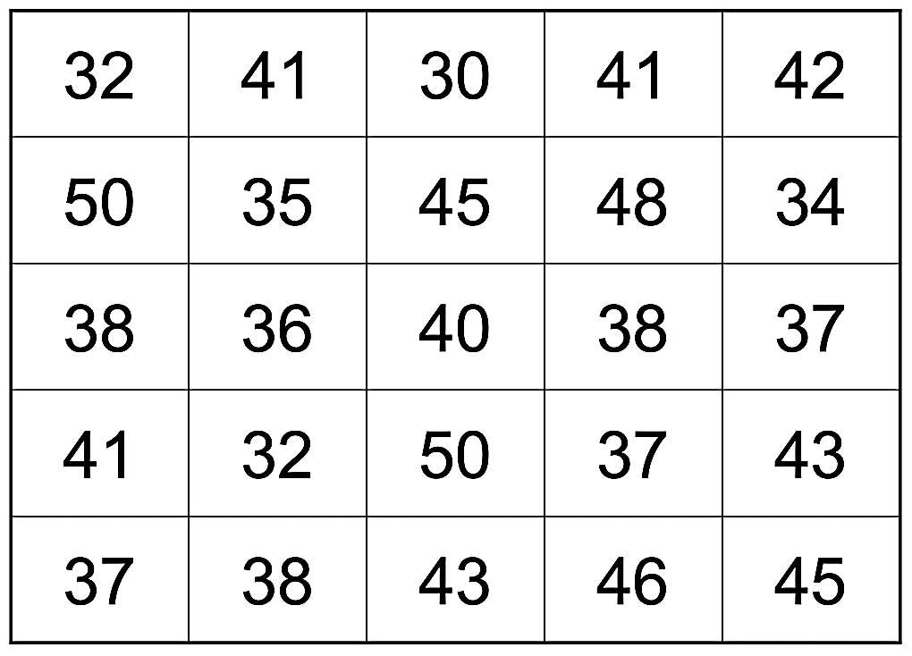
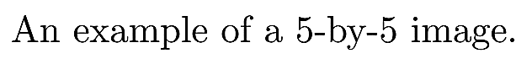
Histogram Equalization (cont.)

Slide 18
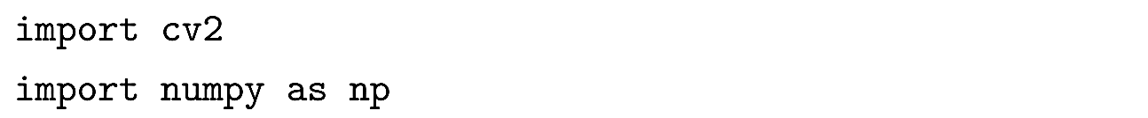
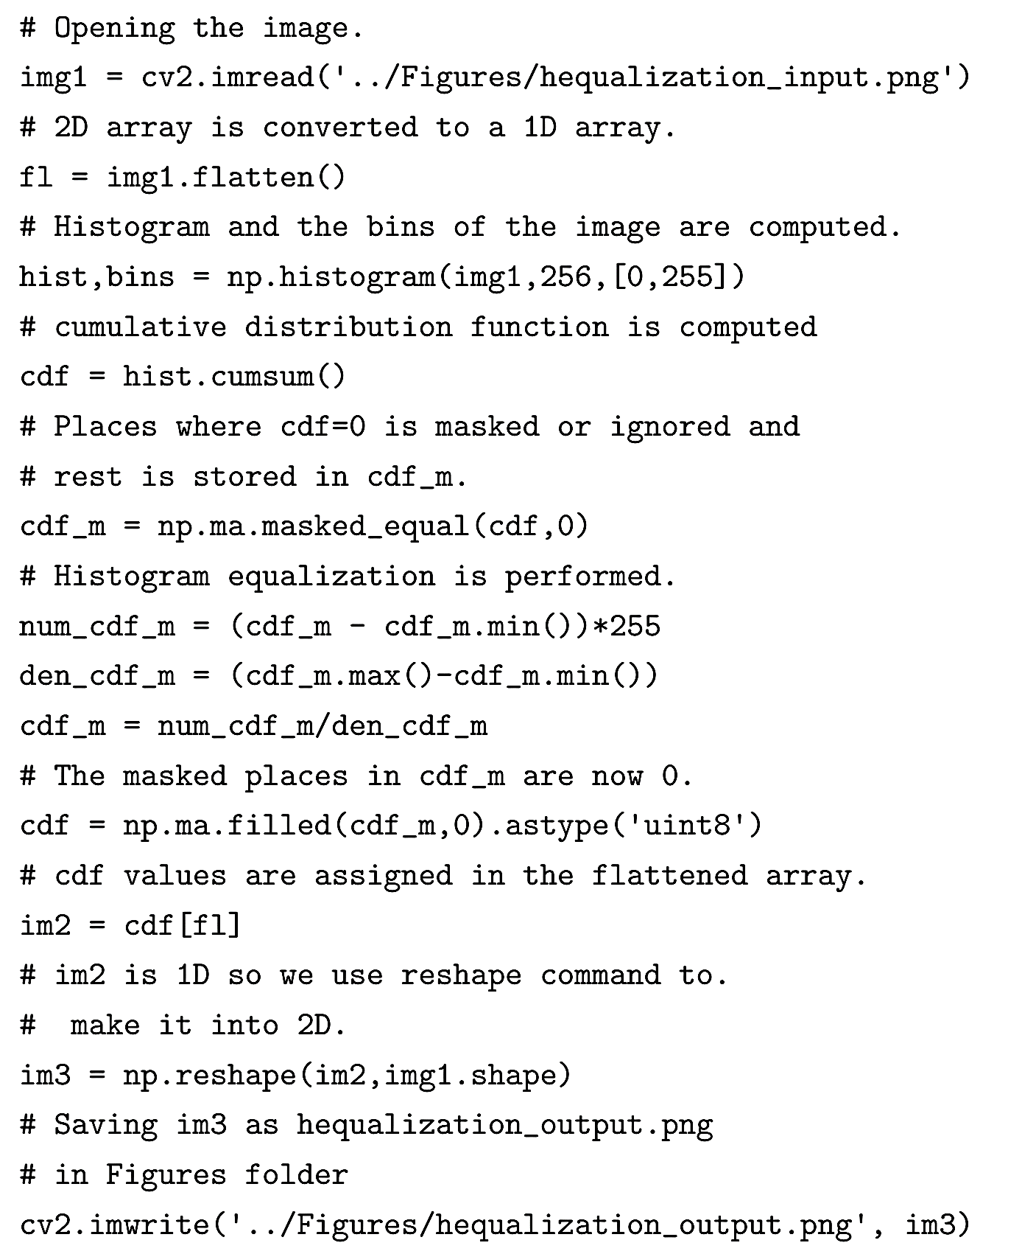
Histogram Equalization (cont.)

Slide 19
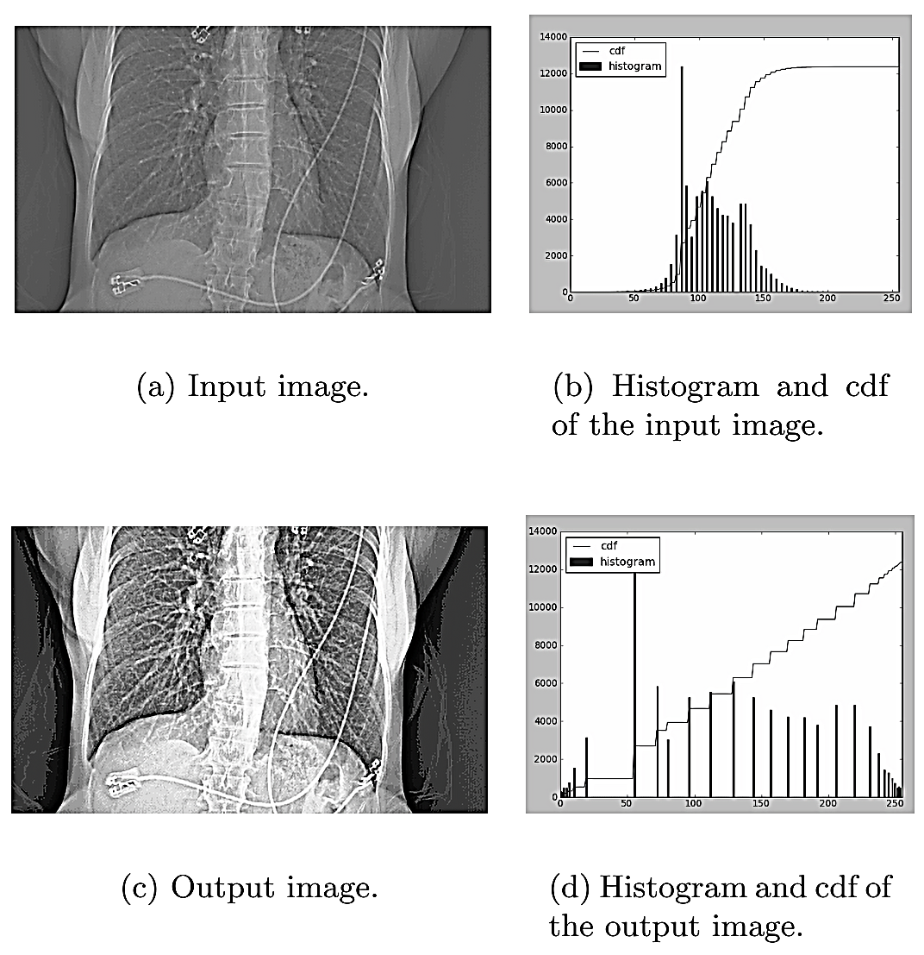
Histogram Equalization (cont.)

Slide 20
Contrast Limited Adaptive Histogram Equalization (CLAHE)
Instead of using the histogram of the whole image, in Contrast Limited Adaptive Histogram Equalization, the image is divided into small regions and a histogram of each region is computed.
Divide the input image into sub-images of size 8-by-8
Calculate the histogram of each sub-image.
Find a PDF as described in previous section.
Set a threshold to clip the histograms. If the histogram of any bin crosses the clip limit, then the pixels above the clip limit are uniformly distributed to other bins.
Apply histogram equalization to each sub-image.
Bilinear interpolation is applied to remove artifacts at the boundary of sub-images.

Slide 21
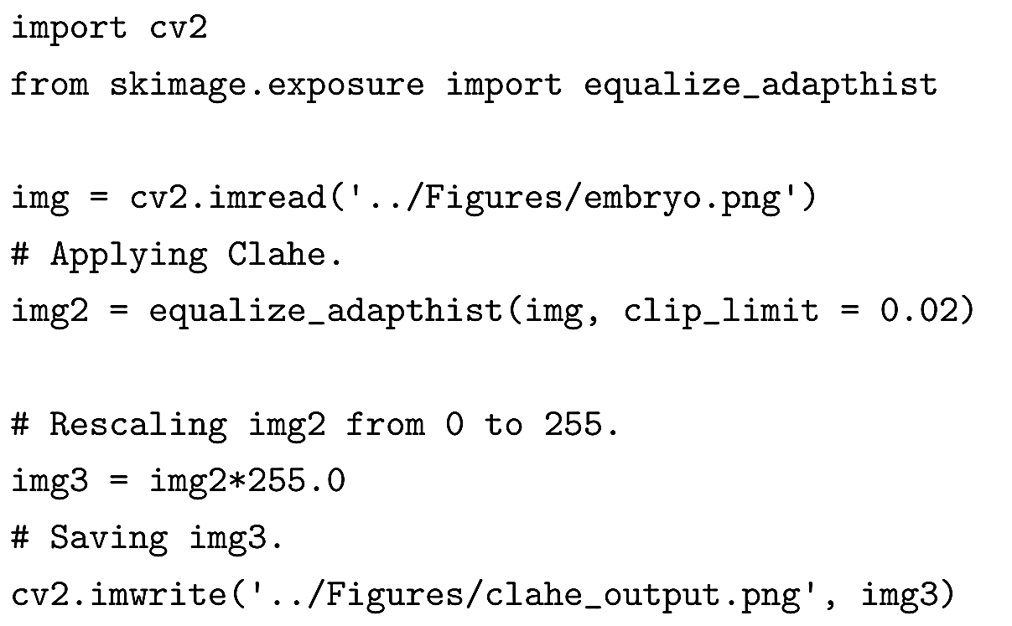
Contrast Limited Adaptive Histogram Equalization (CLAHE)

Slide 22
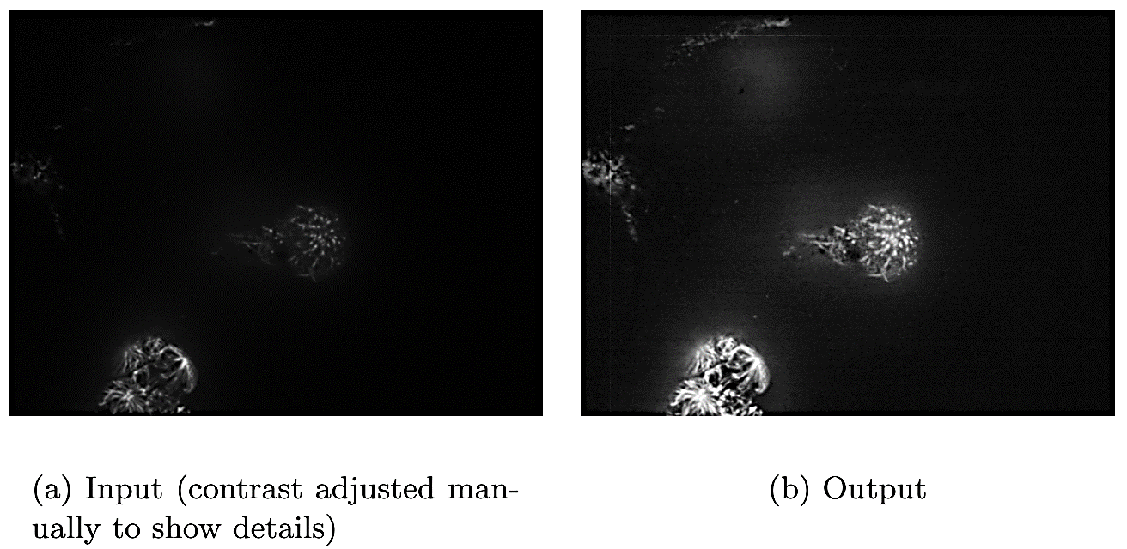
Contrast Limited Adaptive Histogram Equalization (CLAHE)

Slide 23
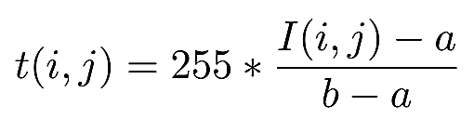
Contrast Stretching
Contrast stretching is used to increase the pixel value range by rescaling the pixel values in the input image.
Contrast stretching is similar in idea to histogram equalization except that the pixel intensities are rescaled using the pixel values instead of probabilities and CDF.
The contrast stretching transformation, t(i,j) is given by the following equation:
where I(i,j), a, and b are the pixel intensity at (i,j), the minimum pixel value and the maximum pixel value in the input image respectively.

Slide 24
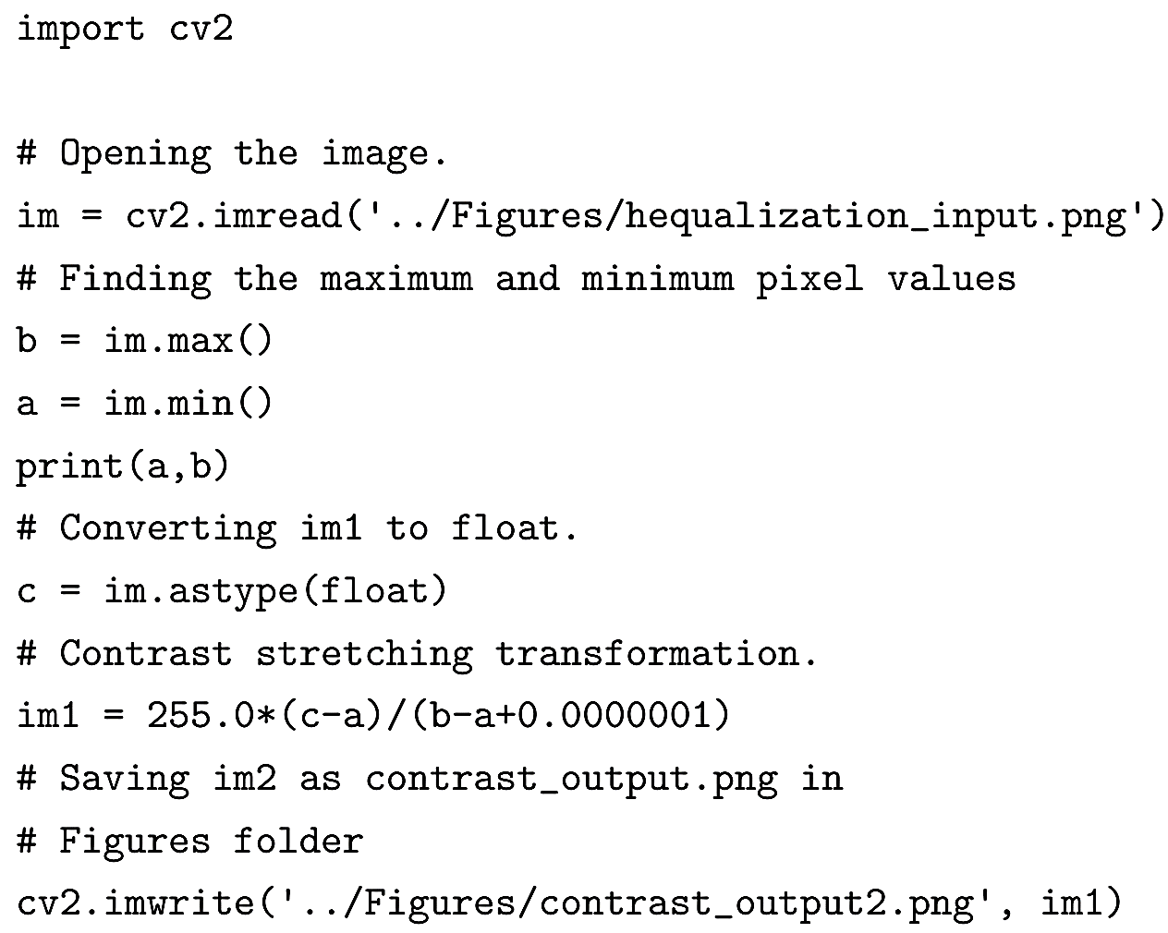
Contrast Stretching (cont.)

Slide 25
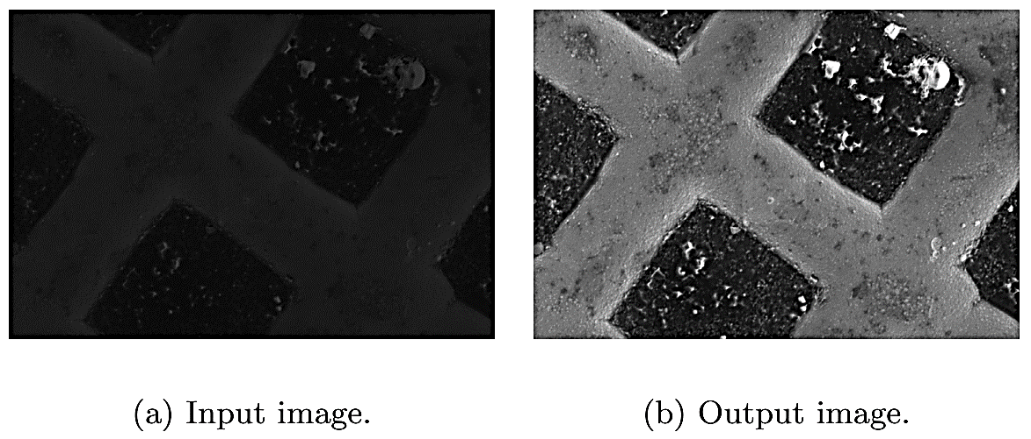
Contrast Stretching (cont.)
An example of contrast stretching where the pixel value range is significantly different from [0,255].

Slide 26
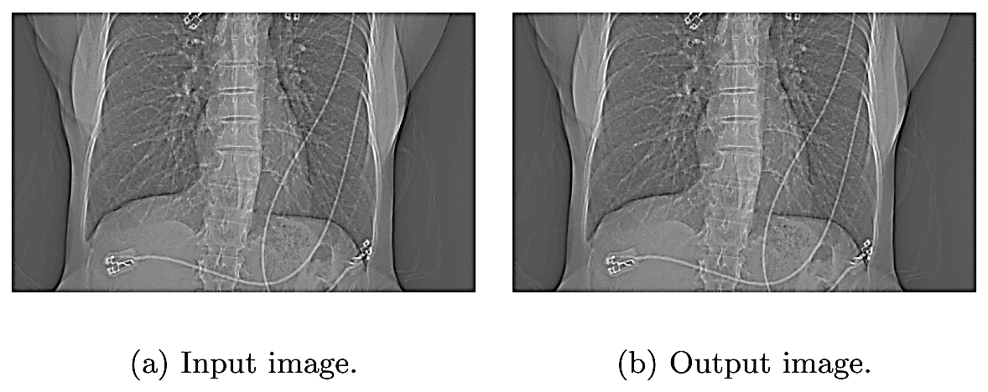
Contrast Stretching (cont.)
An example of contrast stretching where the input pixel value range is same as [0,255].

Slide 27
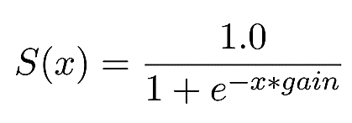
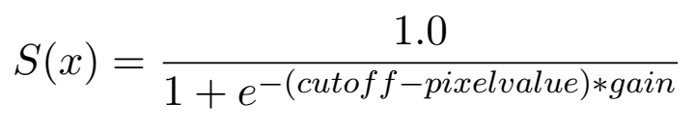
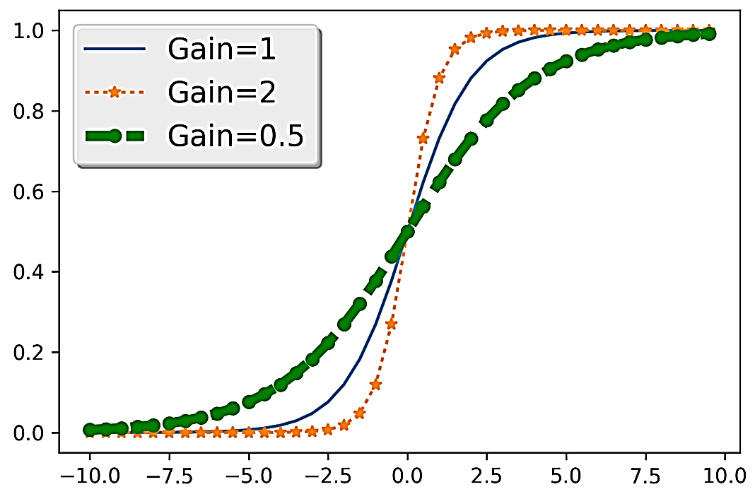
Sigmoid Correction
A sigmoid function is defined as:

Slide 28
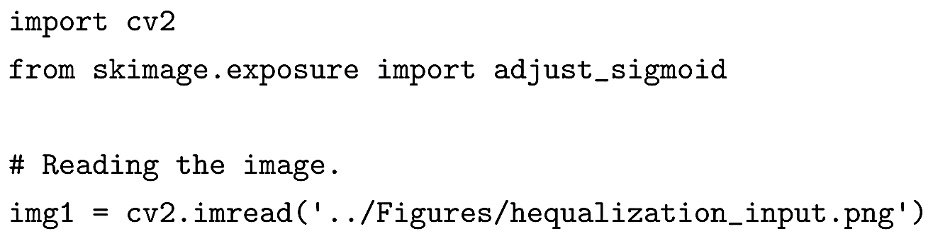
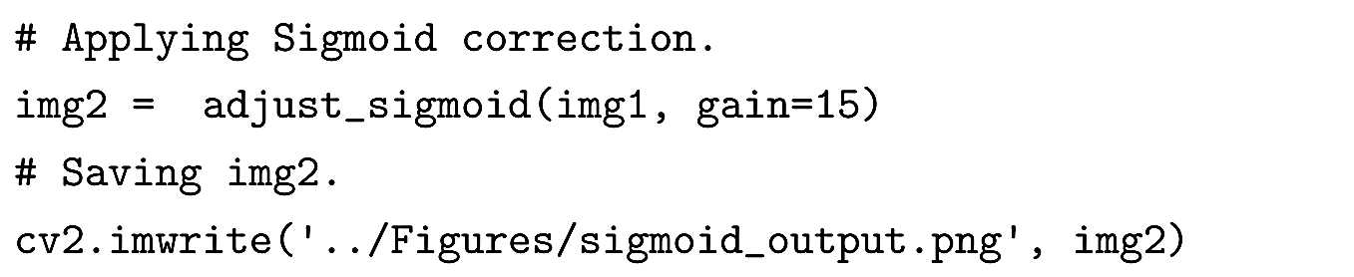
Sigmoid Correction (cont.)

Slide 29
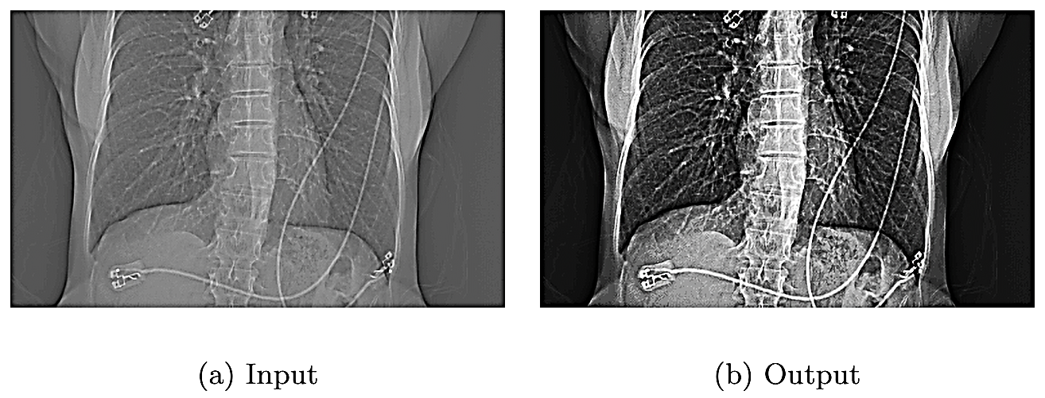
Sigmoid Correction (cont.)

Slide 30
Local Contrast Normalization
Local Contrast Normalization method demonstrates that enhancing the pixel value at a certain location depends only on its neighboring pixels and not the ones farther away from it. The method works by setting the local mean of a pixel to zero and its standard deviation to 1 based on the pixels in the neighborhood.
The method works by setting the local mean of a pixel to zero and its standard deviation to 1 based on the pixels in the neighborhood.

Slide 31
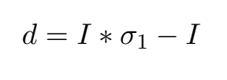
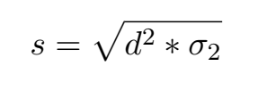
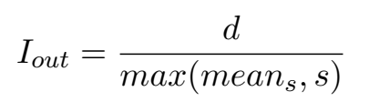
Local Contrast Normalization (cont.)
Creating a difference image (d), computed by finding the difference between the smoothed version of the image and itself.
The difference image is then used to compute the standard deviation image after applying a Gaussian smoothing.
The final image I_{out} is created by dividing the difference image by the maximum between the local mean of the standard deviation image and the standard deviation image.

Slide 32
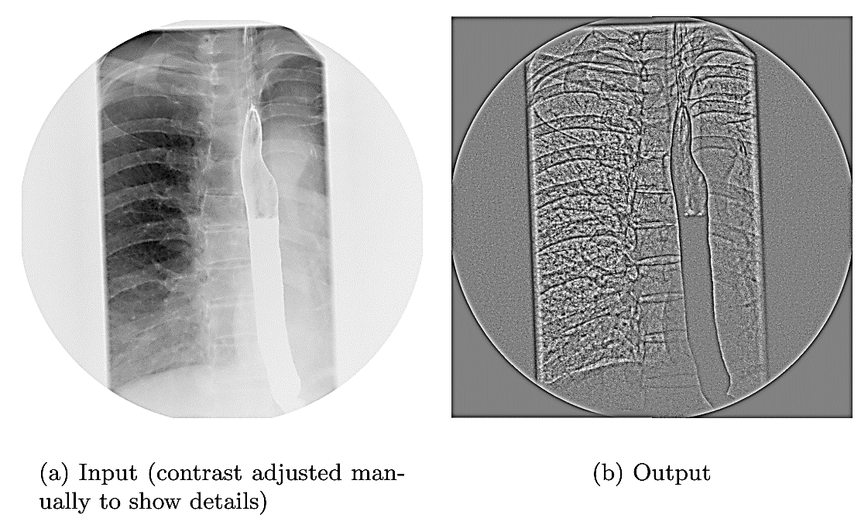
Local Contrast Normalization (cont.)

